Slide 1
20190109
Lab meeting
Lee Jong Geon

Slide 2
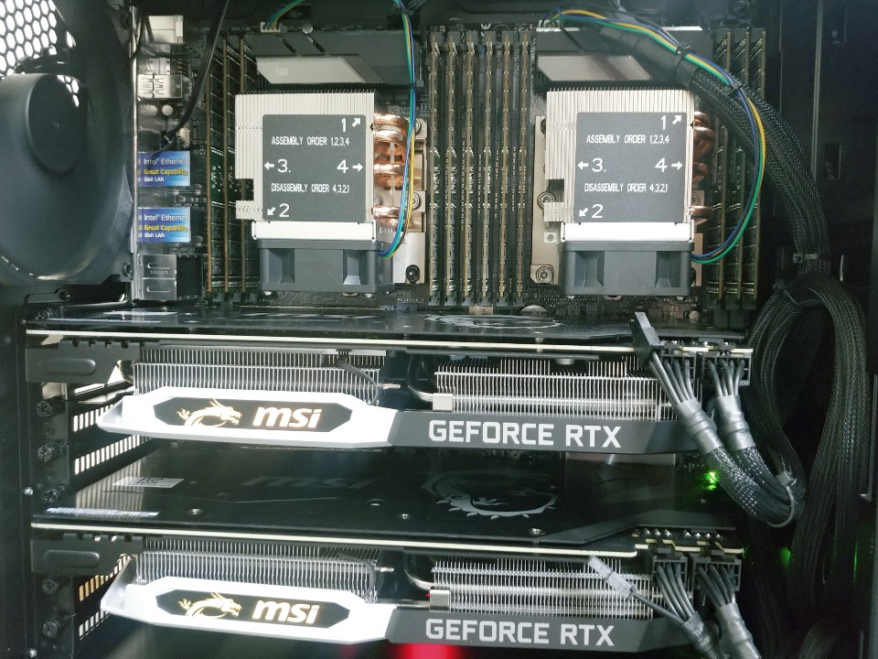
2 CPU
2 GPU
No | 품 명 | 사 양 (Specification) | 수 량
1 | CPU | INTEL 제온 스케일러블 실버 4114 (스카이레이크/2.2GHz/13.75MB) | 2 | 10 core / 20 thread * 2 = 20 core / 40 thread
2 | RAM | 삼성 DDR4 32GB RAM/PC4-19200R/ECC/REG 서버용메모리 | 12 | 32GB * 12 = 384 384/40 = 9.6 GB/thread
3 | GPU | MSI 지포스 RTX 2070 아머 D6 8GB | 2 | 2304 CUDA * 2
4 | SSD | 삼성 860 PRO Series SSD (MZ-76P1T0B/BW) [1TB] | 1
5 | POWER | EVGA SUPERNOVA 1000G+ 80PLUS GOLD 파워 (ATX/1000W) | 1

Slide 3
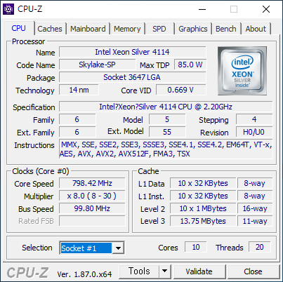

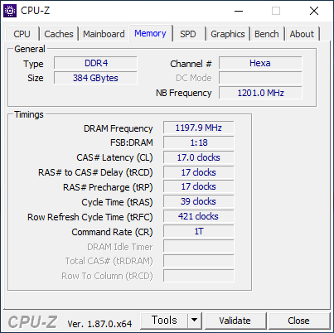
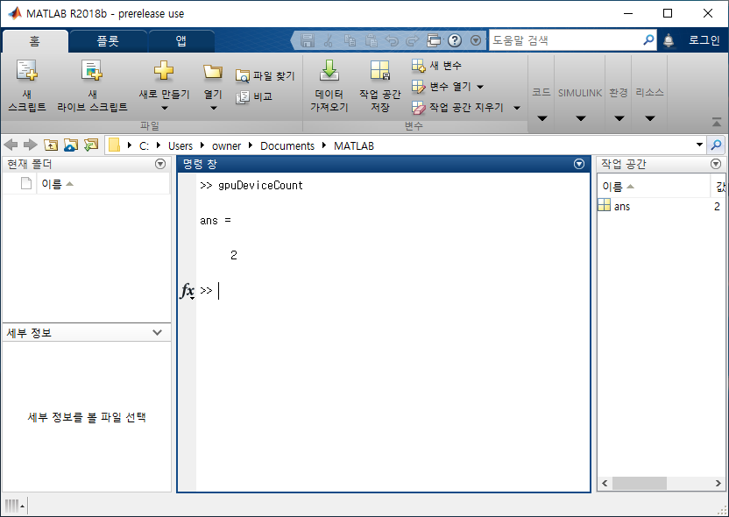
장치 인식 check
MATLAB에서 인식하는 GPU device를 count하는 함수

Slide 4
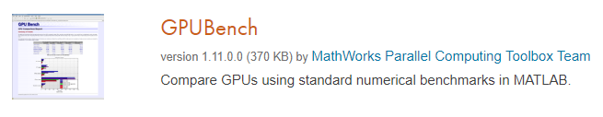
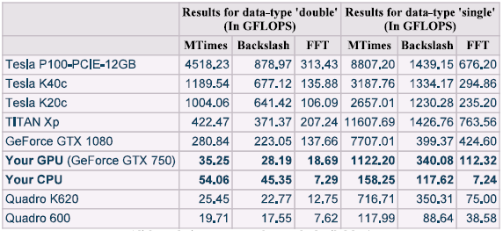
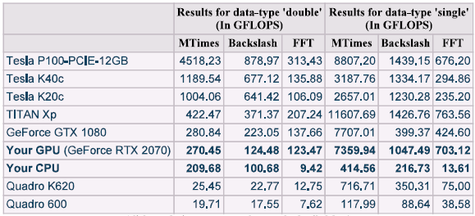
MATLAB 성능 test (기존 PC vs GPU Workstation)
기존 PC
GPU workstation
GPU 1개 성능
X 46
X 9
X 97
Mtimes: 행렬 연산
Backlash: 나눗셈

Slide 5
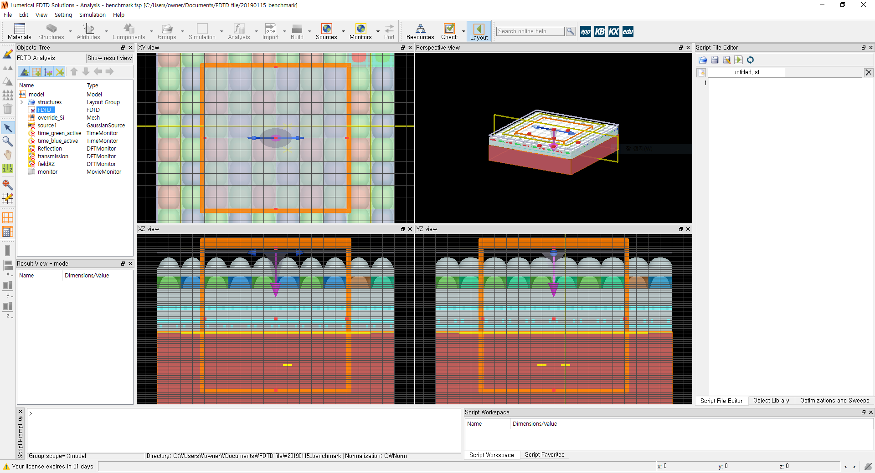
FDTD 성능 test (Cluster vs GPU Workstation)
CMOS image sensor simulation to benchmark FDTD solver speed.
(https://kx.lumerical.com/t/fdtd-simulation-benchmarks/22117)
 | Cluster | GPU workstation
CPU | Intel i5 750 (2009) | Intel Xeon silver 4114 (2017)
Spec. | ( 4 core / 4 thread ) * 16 ea = 64 core / 64 thread | ( 10 core / 20 thread ) * 2 ea = 20 core / 40 thread
Time to run (s) | 518 | 483
FDTD solver speed (Mnodes/s) | 5.76949 | 9.87743
Total FDTD solver speed (Mnodes/s) | 369.247 | 395.097

